Slide 1


INTRODUCTION TO FIXATION AUTOLYSIS, BACTERIAL DECOMPOSITION
MLS 344 3 unit
OSIAGWU DANIEL

Slide 2
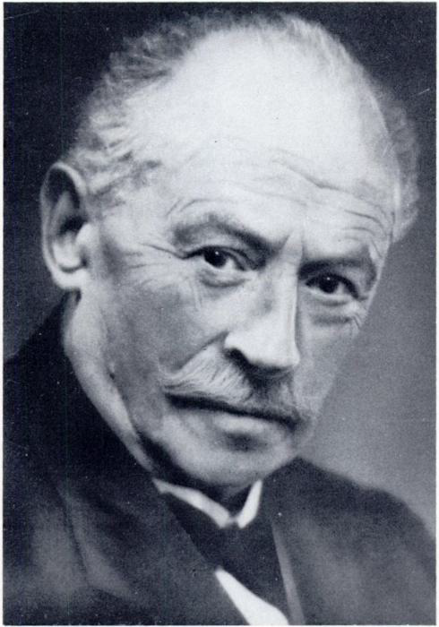
FERDINAND BLUM
FATHER OF HISTOLOGICAL
FIXATION
Bone 3rd october 1865
Frankfurt, Garmany.

Slide 3
INTRODUCTION
WHAT IS FIXATION ?
Fixation is the use of chemical substances to prevent tissue samples from undergoing autolysis and putrefaction. This autolysis and putrefaction is caused by enzymes and microorganism present in the tissue. It helps in maintaining the tissue architecture and chemistry as life-like as possible after death.
Fixation is a complex series of chemical process which brings about changes in the various chemical constituents of the cell, however the cell morphology and structural detail is preserved in a life-like manner as possible after death.
It is a critical step in the preparation of histological sections by which biological tissues are preserved from decay, thereby preventing autolysis or putrefaction.

Slide 4
PRINCIPLE OF FIXATION
The fixative brings about cross-linking of proteins which produces denaturation or coagulation of the proteins so that the semi-fluid state is converted into semisolid state; such that the fixative maintains everything in-vivo in relation to each other.

Slide 5
The semisolid state facilitate easy manipulation of the tissue.
If a fresh tissue is kept as it is at room temp., it will become liquefied.
It will also produce foul odor mainly due to the action of bacteria and enzymes i.e. putrefaction and autolysis.
NOTE:
Unless a tissue is fixed soon after it’s removal from the body it will undergo degenerative changes caused by autolysis and putrefaction, these changes will eventually course the loss of the morphology of the individual cell.

Slide 6
AIM OF FIXATION
The first aim of fixation is
To preserve the tissue in a life-like manner as possible.
Prevent postmortem changes like autolysis and putrefaction.
Autolysis: Is the lysis (destruction or dissolution of cells) by enzymatic action probably as a result of rupture of the lysosomes.
Putrefaction: The breakdown of tissue by bacterial action often with formation of gas.

Slide 7
Preservation of chemical compounds and microanatomic constituents in the tissue so that further histochemistry is possible.
Hardening : the hardening effect of fixatives allows easy manipulation of soft tissue like brain, intestines etc.
Solidification: Converts the normal semi-fluid consistency of cells (gel) to an irreversible semisolid consistency (solid).
Optical differentiation –
It alters to varying degrees the refractive indices of the various components of cells and tissues so that unstained components are more easily visualized than when unfixed

Slide 8
Effects of staining –
Certain fixatives like formaldehyde intensifies the staining character of tissue especially with haematoxylin.
Support high quality and consistent staining with Haematoxylin and eosin (H&E)
Histochemical
Immunohistochemical stain both initially and after storage of the paraffin blocks for at least a decade.
The fixative must have the ability to prevent long and short term destruction of the micro-architecture of the tissue by stopping the activity of catabolic enzymes and hence, autolysis, minimizing the diffusion of soluble molecules from their original locations.
Another characteristics of a good fixative is the destruction of infectious agents - maintaining tissue and cellular integrity.

Slide 9
Generally the major objective of fixation in pathology is:-
Maintain clear and consistent morphological features.
Preserves and stabilizes cell morphology and tissue architecture
Inactivates proteolytic enzymes that could otherwise degrade the sample
Strengthens samples so that they can withstand further processing and staining
Protects samples against microbial contamination and possible decomposition.

Slide 10
PROPERTIES OF A GOOD FIXATIVE
To preserve the tissue in a life-like manner as possible.
Prevent postmortem changes like autolysis and putrefaction.
Preservation of chemical compounds and microanatomic constituents in the tissue so that further test on the tissue is possible.
Hardening.
Solidification: Converts the normal semi-fluid to an irreversible semisolid form.
Optical differentiation - it alters to varying degrees the refractive
Effects of staining: intensifies the staining character of tissue

Slide 11
Solubility of fixatives - All fixatives should be soluble in a suitable solvent, preferably in water so that adequate concentrations can be prepared.
Concentration - It is important that the concentration of fixative is isotonic or hypotonic
Penetration. The Faster a fixative can penetrate the tissue better is its penetration power which depends upon the molecular weight e.g. formalin fixes faster than osimic acid.

Slide 12
COMMON METHODS OF FIXATION
Perfusion:
Tissues can be perfused with fixative following removal of fluids.
Immersion:
Samples are immersed in fixative which then diffuses into and through the tissue or cell sample. Immersion and perfusion are combined to ensure thorough fixation throughout the tissue.
Freezing:
Samples with antigens that are too labile for chemical fixation or exposure to the organic solvents used for de-paraffinization can be embedded in a cryoprotective embedding medium, such as optimal cutting temperature (OCT) compound, and then snap-frozen and stored in liquid nitrogen.
Drying:
Blood smears for ICC staining are air-dried and waved across a flame to heat-fix the cells to the slide.

Slide 13
FACTORS AFFECTING THE QUALITY OF FIXATION
Concentration
Temperature
Additives
Volume
Buffer and pH
Size of specimen
Duration of fixation
Concentration –
High concentration of fixative e.g. formalin above 10% tends to cause increased hardening and shrinkage
Temperature –
Diffusion of molecules increases with rising temperature due to their more rapid movement and vibration. e.g. formaldehyde at higher temp. Using microwave.

Slide 14
Additives –
Additives such as electrolyte and non-electrolyte added to fixatives improves the morphology of the fixed tissue.
ELECTROLYTES
Calcium chloride
Ammonium sulphate
Potassium dihydrogen phosphate
Potassium thio –Cyanate
NON-ELECRTROLYTES
Dextran
Sucrose
Detergent
Size of specimen and Duration of fixation –
The dept. reached by a fixative has been found to be directly proportional to the square root of fixation

Slide 15
Volume
The volume of fixative should be at least ten to 20 times the volume (bulk) of tissue for optimal, rapid fixation.
For museum specimens the volume of fixative can be greater 50 times the volume of sample.
Thin specimen may be fixed in NBF for 5 - 6 hours.
Note :
If the specimen is large then see that the sections are made to make slices which have a thickness of about 1.5 cm so that fixative can penetrate the tissue easily.

Slide 16
Buffer and pH
The choice of buffers depends on type of fixative and analyte.
Phosphate
Bicarbonate
Tris and acetate. buffers help Cytoskeletal elements
The effect of pH with formaldehyde may be very high depending on the application to which the tissue.
Pigmentation increases at Ph of 3.0 - 5.0 formalin pigment is seen.
Remove with alcoholic solution of picric acid.

Slide 17
Osmolality and ionic composition –
Hypertonic and hypotonic solutions causes shrinkage and swelling of tissues.
If cells are fixed in a hypertonic solution, the cells may shrink.
If the cells are fixed in a hypotonic solution, the cells may swell and burst.
For best result use solution with slight hypertonicity e.g. 10% NBF is about 1500m.
Ions such as NA+, K+, Ca2+ e.t.c affect shape and structure of cell regardless of osmotic effect. The ionic composition of fluid should be very isotonic.

Slide 18
NOTE:
Components of a compound fixative penetrate at different rates.
Gross specimen should not be thicker than 0.5 cm.
They should not be left sitting in a bucket.
Fixative inactivates proteins.
Those in blood or blood fluids and bloody gross specimen should be washed with saline prior to being put into fixatives.

Slide 19
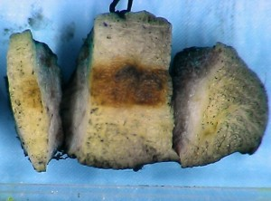

Slide 20
WHY SO MANY FIXATIVES ?
Understanding of the biological functions and structure of tissues has led to the development of many fixatives.
The mechanism and principle to which specific fixative acts to carry out functions such as hardening and prevention
Preservation of specific tissue molecules falls into broad categories, namely : -
Dehydration
Effect of acids
Salt formation
Covalent addition of reactive groups and of cross-links
Heat

Slide 21
ADVANTAGES AND DISADVANTAGES.
Loss of molecules from fixed tissues
Swelling or shrinkage of tissues during process
Variation in quality : Histochemical Immunohistochemical staining
Ability to perform biochemical analysis accurately
Varying capabilities to maintain structure of cellular organelles.

Slide 22
Several studies has also shown that fixation using formaldehyde has lead to the loss of antigen immunorecognition.
This loss is due to the type of fixation combined with processing. (Eltoum et al ., 2001a. 2001b)
Analysis of mRNA and DNA from FFPE tissues has been very problematic. (Grizzle et al ., 2001)
NOTE:
In general good aspects of fixatives are combined and balanced with less desirable features.
All widely used fixatives are selected with by compromise.

Slide 23
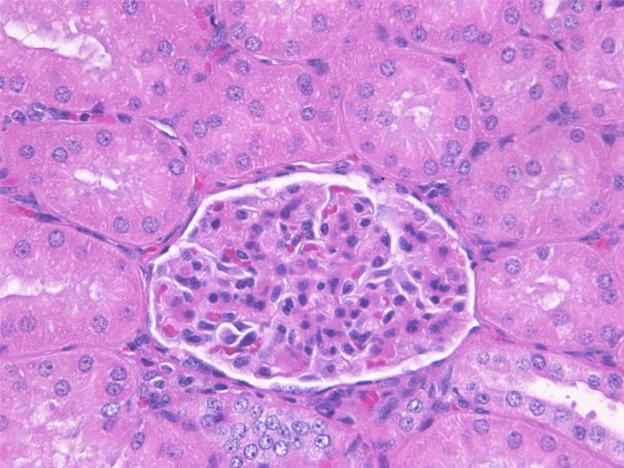
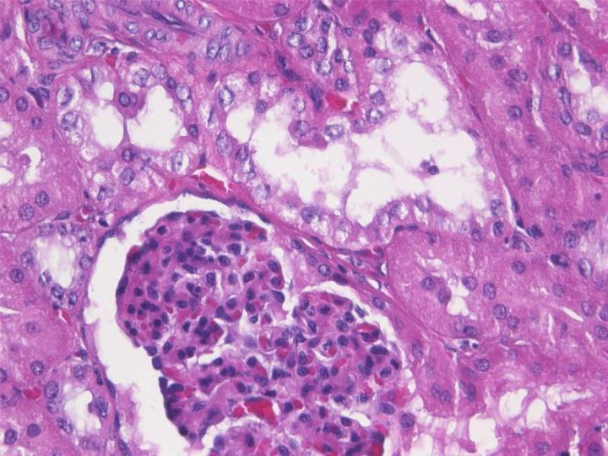
Figure 1: A paraffin section of kidney that has been fixed using neutral buffered formalin. This is an example of well-fixed tissue showing good nuclear and cytoplasmic morphology with minimal shrinkage showing clearly defined basement membranes and cell margins.
Figure 2: A paraffin section of kidney that has been fixed using neutral buffered formalin. This is an example of poorly-fixed tissue showing inferior nuclear and cytoplasmic morphology with excessive shrinkage and poorly defined cell margins. Note the vacuolation and fragmentation of both nucleus and cytoplasm of cells of the distal tubule and retraction of the glomerulus due to shrinkage.
Adapted from www.leicabiosystems.com/knowledge-pathway/fixation

Slide 24
REFERENCES
Bancroft, J.D. and Gamble. M., (2008) Theory and Practice of histological techniques ed. 6th, Churchill Livingstone inc. . Edinburgh. London, Melbourne and New York.
Avwioro, O.G. , Histochemistry and tissue pathology principle and techniques. , Ed. 1 Claverianum Centre. P.O. Box 4017. U.P.O., Ibadan.
Horobin, R.W. (2002) Theory of staining and its practical implications. In Theory and Practice of Histological Techniques, 5th edn (eds J.D. Bancroft and M. Gamble). Edinburgh: Churchill Livingstone.
Kiernan, J.A. (2001) Histological and Histochemical Methods, 3rd edn. Oxford: Hodder Arnold.

Slide 25
Thank you
‘’ Visions sometimes have a way of becoming reality for those who believe in the power of positive thinking’’.

